Slide 1

Code Refactoring and Bug Fixing

Slide 2
Agenda
Refactor the existing codebase and ensure the proper functioning of the Note Taking Application. Document all identified bugs during the debugging process. Remember, the task is not about recreating the app from scratch. Your goal is to fix the already existing codebase and make the application work as intended

Slide 3
Introduction
In this Task we are trying to create flask web application where users can submit notes through a form and see the list of notes displayed on the home page.
Flask: Flask is a python web framework that provides tools and libraries to build web applications
Render template: Flask’s render template function is used to render HTML templates, allowing dynamic content generation.
Request: The request object from Flask is used to access data submitted by the client, such as form data
HTML templates: HTML templates are used to define the structure and layout of web pages.

Slide 4
Functionality
The Flask web application performs as follows
Home Page : The home page serves as the main interface for users. It displays a form where users can submit notes.
Note Submission : Users can submit notes through the form on the home page. When a note is submitted, it is added to the list of notes.
Note Display : The list of notes is displayed on the home page, allowing users to view previously submitted notes.
POST and GET requests : The application handles both POST and GET requests. POST requests are used to submit notes, while GET requests are used to retrieve and display the home page.

Slide 5
Improvements
The index functions is suitable for GET requests not POST request
Inappropriate request arguments retrieval
We should use request.form to access form data instead of request.args.get(‘notes’)
In the HTML template action was not defined, changed the button type to submit so that It submits form data when clicked.

Slide 6
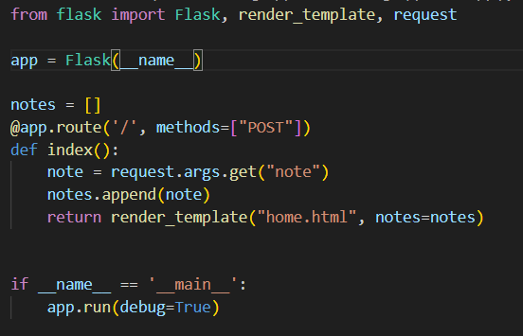
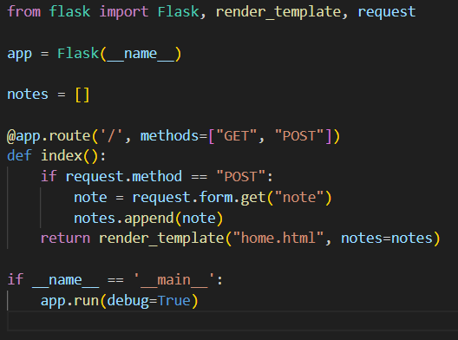
Version Control
VERSION 1
VERSION 2

Slide 7
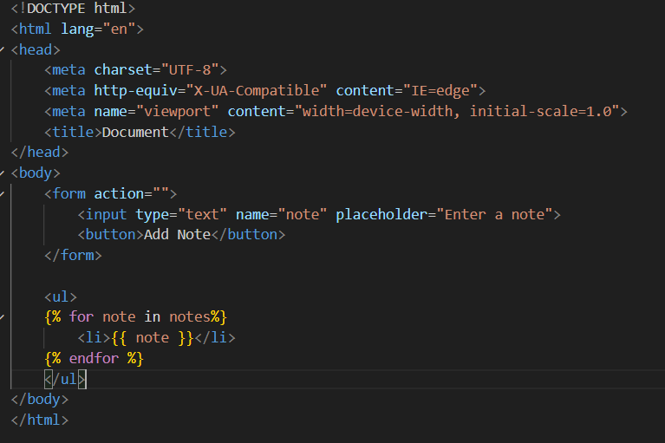
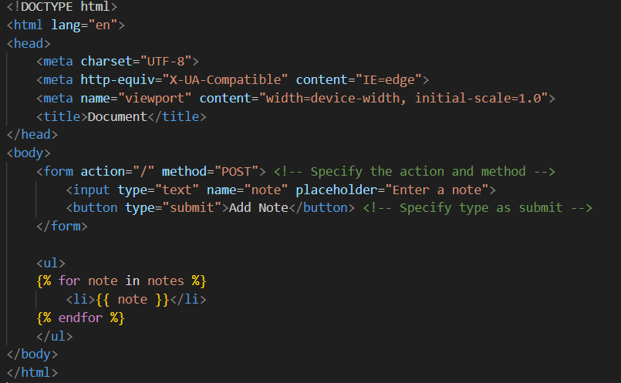
Version 1
Version 2

Slide 8
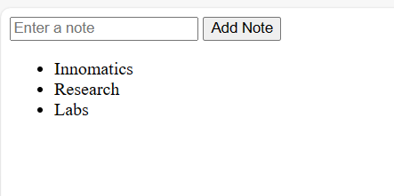
Web Application

Slide 9

THANK YOU

